Slide 1
Presentation on
Cloud Computing
Himshikha Rai,15756
Aakankshya Pradhanang ,15793

Slide 2
What is Cloud Computing?
an umbrella term used to refer to Internet based development and services
used to describe a new class of network based computing that takes place over the Internet,
hides the complexity
Hides details of the underlying infrastructure from users and applications
provides very simple graphical interface or API (Applications Programming Interface).

Slide 3
What is Cloud Computing?
provides on demand services, that are always on, anywhere, anytime and any place.
Pay for use and as needed, elastic
  scale up and down in capacity and functionalities
The hardware and software services are available to
  general public, enterprises, corporations and businesses markets

Slide 4

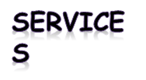
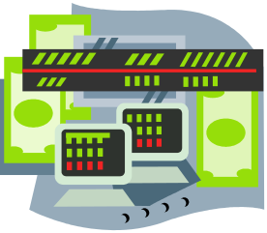

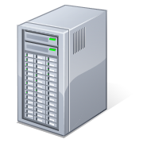
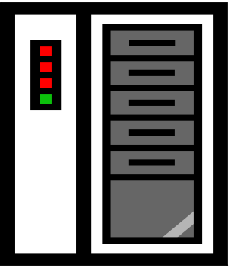

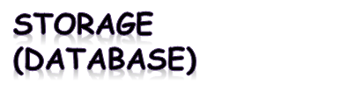

What is Cloud Computing
Shared pool of configurable computing resources
On-demand network access
Provisioned by the Service Provider
Adopted from: Effectively and Securely Using the Cloud Computing Paradigm by peter Mell, Tim Grance
Notes:
Cloud computing is a model for enabling convenient, on-demand network access to a shared pool of configurable computing resources (e.g., networks, servers, storage, applications, and services) that can be rapidly provisioned and released with minimal management effort or service provider interaction.
cloud computing customers do not own the physical infrastructure.
Cloud computing users avoid capital expenditure (CapEx) on hardware, software, and services when they pay a provider only for what they use.
Low shared infrastructure and costs, low management overhead, and immediate access to a broad range of applications

Slide 5
Cloud Computing Characteristics
Common Characteristics:
Massive Scale
Resilient Computing
Homogeneity
Geographic Distribution
Virtualization
Service Orientation
Low Cost Software
Advanced Security
Essential Characteristics:
On Demand Self-Service
Broad Network Access
Rapid Elasticity
Resource Pooling
Measured Service
Adopted from: Effectively and Securely Using the Cloud Computing Paradigm by peter Mell, Tim Grance
Notes:
ScalabilityInfrastructure capacity allows for traffic spikes and minimizes delays.
ResiliencyCloud providers have mirrored solutions to minimize downtime in the event of a disaster. This type of resiliency can give businesses the sustainability they need during unanticipated events.
Homogeneity: No matter which cloud provider and architecture an organization uses, an open cloud will make it easy for them to work with other groups, even if those other groups choose different providers and architectures.
On-demand self-service. A consumer can unilaterally provision computing capabilities, such as server time and network storage, as needed automatically without requiring human interaction with each service’s provider.
Broad network access. Capabilities are available over the network and accessed through standard mechanisms that promote use by heterogeneous thin or thick client platforms (e.g., mobile phones, laptops, and PDAs).
Resource pooling. Multi-tenant model.. There is a sense of location independence in that the customer generally has no control or knowledge over the exact location of the provided resources but may be able to specify location at a higher level of abstraction (e.g., country, state, or datacenter). Examples of resources include storage, processing, memory, network bandwidth, and virtual machines.
Rapid elasticity. Capabilities can be rapidly and elastically provisioned, in some cases automatically, to quickly scale out and rapidly released to quickly scale in. To the consumer, the capabilities available for provisioning often appear to be unlimited and can be purchased in any quantity at any time.
Measured Service. Cloud systems automatically control and optimize resource use by leveraging a metering capability at some level of abstraction appropriate to the type of service (e.g., storage, processing, bandwidth, and active user accounts).

Slide 6
Different Cloud Computing Layers‏
MS Live/ExchangeLabs, IBM,
Google Apps; Salesforce.com
Quicken Online, Zoho, Cisco
Application Service
(SaaS)‏
Google App Engine, Mosso,
Force.com, Engine Yard,
Facebook, Heroku, AWS
Application Platform
Server Platform
3Tera, EC2, SliceHost,
GoGrid, RightScale, Linode
Storage Platform
Amazon S3, Dell, Apple, ...

Slide 7
Cloud Computing Service Layers
Services
Description
Services
Services – Complete business services such as PayPal, OpenID, OAuth, Google Maps, Alexa
Application
Focused
Application
Application – Cloud based software that eliminates the need for local installation such as Google Apps, Microsoft Online
Development
Development – Software development platforms used to build custom cloud based applications (PAAS & SAAS) such as SalesForce
Platform
Platform – Cloud based platforms, typically provided using virtualization, such as Amazon ECC, Sun Grid
Storage
Infrastructure
Focused
Storage – Data storage or cloud based NAS such as CTERA, iDisk, CloudNAS
Hosting
Hosting – Physical data centers such as those run by IBM, HP, NaviSite, etc.

Slide 8
What is the purpose and benefits?
Cloud computing enables companies and applications, which are system infrastructure dependent, to be infrastructure-less.
By using the Cloud infrastructure on “pay as used and on demand”, all of us can save in capital and operational investment!
Clients can:
  Put their data on the platform instead of on their own desktop PCs and/or on their own servers.
  They can put their applications on the cloud and use the servers within the cloud to do processing and data manipulations etc.

Slide 9
Cloud-Sourcing
Why is it becoming a Big Deal:
  Using high-scale/low-cost providers,
  Any time/place access via web browser,
  Rapid scalability; incremental cost and load sharing,
  Can forget need to focus on local IT.
Concerns:
  Performance, reliability, and SLAs,
  Control of data, and service parameters,
  Application features and choices,
  Interaction between Cloud providers,
  No standard API – mix of SOAP and REST!
  Privacy, security, compliance, trust…

Slide 10
Cloud Storage
Several large Web companies are now exploiting the fact that they have data storage capacity that can be hired out to others.
  allows data stored remotely to be temporarily cached on desktop computers, mobile phones or other Internet-linked devices.
Amazon’s Elastic Compute Cloud (EC2) and Simple Storage Solution (S3) are well known examples
  Mechanical Turk

Slide 11
Utility Computing – EC2
Amazon Elastic Compute Cloud (EC2):
  Elastic, marshal 1 to 100+ PCs via WS,
  Machine Specs…,
  Fairly cheap!
Powered by Xen – a Virtual Machine:
  Different from Vmware and VPC as uses “para-virtualization” where the guest OS is modified to use special hyper-calls:
  Hardware contributions by Intel (VT-x/Vanderpool) and AMD (AMD-V).
  Supports “Live Migration” of a virtual machine between hosts.
Linux, Windows, OpenSolaris
Management Console/AP

Slide 12
Opportunities and Challenges
The use of the cloud provides a number of opportunities:
  It enables services to be used without any understanding of their infrastructure.
  Cloud computing works using economies of scale:
    It potentially lowers the outlay expense for start up companies, as they would no longer need to buy their own software or servers.
    Cost would be by on-demand pricing.
    Vendors and Service providers claim costs by establishing an ongoing revenue stream.
  Data and services are stored remotely but accessible from “anywhere”.

Slide 13
Advantages of Cloud Computing
Lower computer costs:
  You do not need a high-powered and high-priced computer to run cloud computing's web-based applications.
  Since applications run in the cloud, not on the desktop PC, your desktop PC does not need the processing power or hard disk space demanded by traditional desktop software.
Improved performance:
  With few large programs hogging your computer's memory, you will see better performance from your PC.

Slide 14
Advantages of Cloud Computing
Reduced software costs:
  Instead of purchasing expensive software applications, you can get most of what you need for free-ish!
    most cloud computing applications today, such as the Google Docs suite.
  better than paying for similar commercial software
    which alone may be justification for switching to cloud applications.

Slide 15
Advantages of Cloud Computing
Instant software updates:
Improved document format compatibility.
Unlimited storage capacity:
Increased data reliability:
Universal document access:

Slide 16
Disadvantages of Cloud Computing
Requires a constant Internet connection:
  Cloud computing is impossible if you cannot connect to the Internet.
  Does not work well with low-speed connections:
  Features might be limited:
  Can be slow:

Slide 17
The Future
Many of the activities loosely grouped together under cloud computing have already been happening and centralised computing activity is not a new phenomena
Grid Computing was the last research-led centralised approach
However there are concerns that the mainstream adoption of cloud computing could cause many problems for users
Many new open source systems appearing that you can install and run on your local cluster
  should be able to run a variety of applications on these systems

